Slide 1
Building a
Tocodynamometer

Slide 2
Cardiotocography (CTG)
Combination of Fetal Heart (cardio-) and Uterine Contraction (toco)
CTG requires interpretation of:
Uterine Activity
Baseline Fetal Heart Rate (FHR)
Baseline FHR variability
Presence of accelerations
Periodic and episodic decelerations
Trends of FHR patterns over time
http://en.wikipedia.org/wiki/Cardiotocography

Slide 3
Some available cardiotocographs:
http://www.4utechcorp.com/products/cardiotocograph.php

Slide 4
Uterine Activity
Frequency (~5 contractions/10min)
Duration
Intensity
Resting Tone
Interval
http://en.wikipedia.org/wiki/Cardiotocography

Slide 5
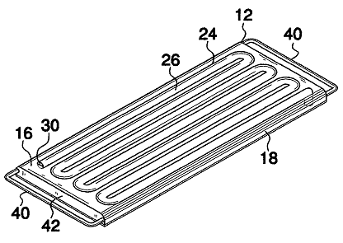
US Patent 7753860
Uses a low viscosity fluid to propagate vibrations from contractions in the uterus
US007753860B1, 13-July-2011

Slide 6
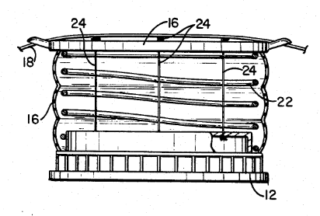
US Patent 4640295
US Patent 4640295, 3-Feb-1987

Slide 7
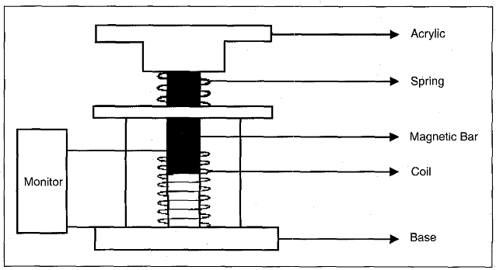
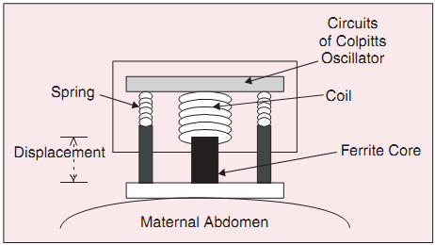
2002
1997
“A Portable Monitor for Fetal Heart Rate and Uterine Contraction”, Chih-Lung et.al., 1997
“Monitoring Long-Term Uterine Contractions”, Han-Chang et.al., 2002

